Slide 1
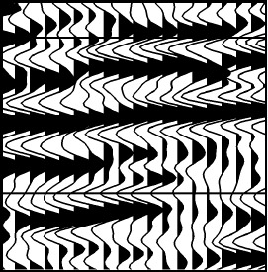

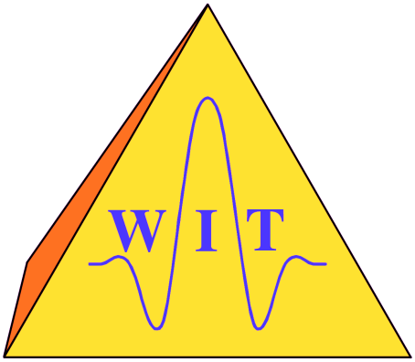

Shahrood University of Technology
Faculty of Mining, Petroleum and Geophysics
A model-based approach to the Common-Diffraction-Surface stack
- a synthetic case study
Hashem Shahsavani¹, Jürgen Mann²,
Iradj Piruz¹, and Peter Hubral²
¹Shahrood University of Technology ²Karlsruhe Institute of Technology
August 16th, 2011

Slide 2
Overview
MBCDS stack
Introduction
Common-Reflection-Surface (CRS) stack
extended Common-Reflection-Surface (CRS) stack
Common-Diffraction-Surface (CDS) stack
Forward modeling
kinematic ray tracing
dynamic ray tracing
Implementation
Summary
Notes:
I will start with a motivation. And then I will explain three latest methods which have been use to simulate the zero offset and how these method deal with conflicting dip. Then I will explain how we use the KRT and DRT as forward modeling tool. Then I will show you the result of our proposed method. And finally a summary.

Slide 3
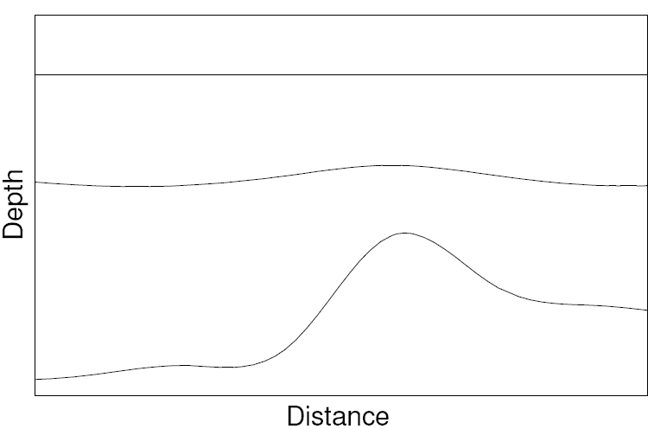
Introduction
MBCDS stack
Common-Reflection-Surface (CRS) stack
R_{NIP}
R_{N}
Notes:
Common-Reflection-Surface (CRS) stack . To obtain the travel time formulation for 2d inhomogeneous model with arbitrarily curve interfaces two hypothetical experiment are performed which yield two different waves. one of these waves is associated with an exploding diffraction which produce NIP wave with the radius Rnip at the surface which has been shown here by the red color. And another wave is associate with an exploding reflector which produce Normal wave with radius Rn at the surface which has been shown here by the green color.
????The Common-Reflection-Surface (CRS) stack method follows the concept of the classical stacking velocity analysis????

Slide 4
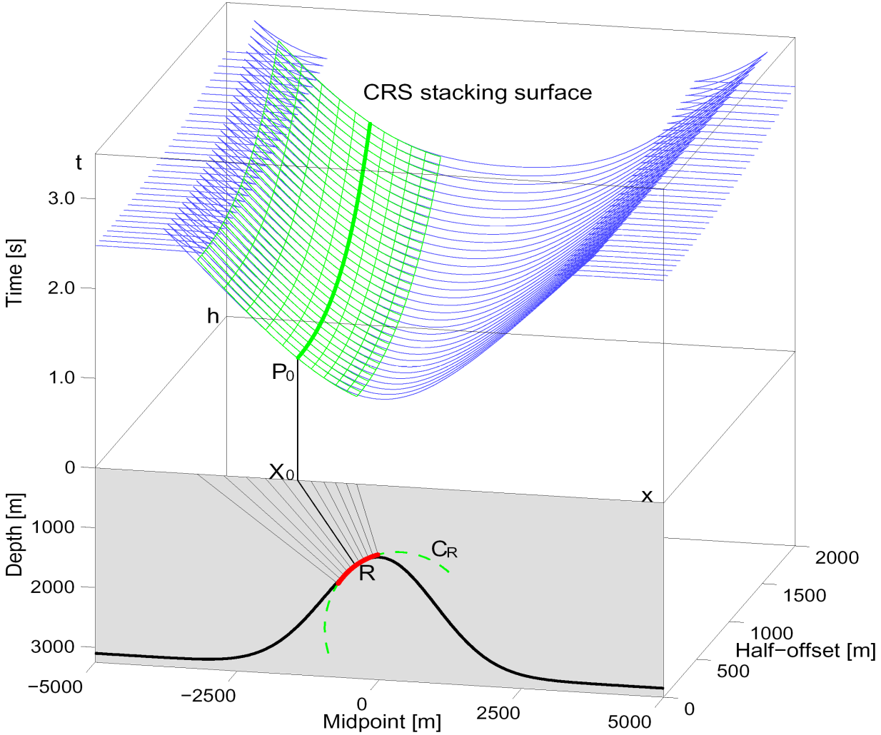
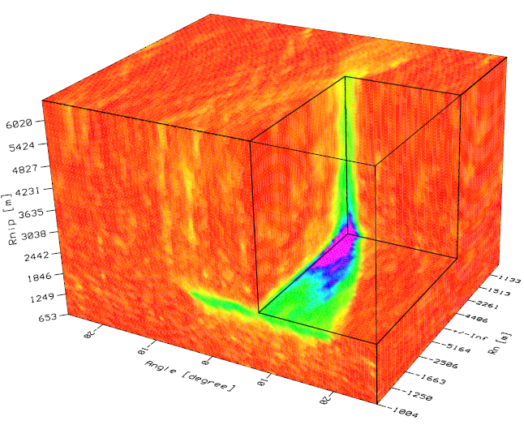
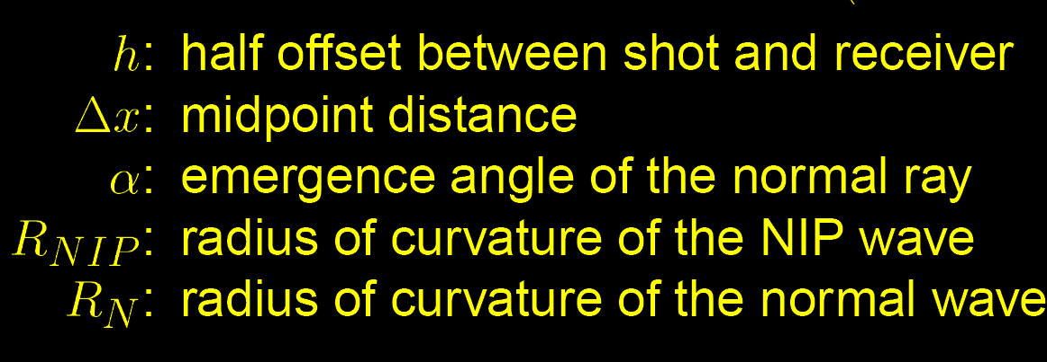
Introduction
MBCDS stack
Common-Reflection-Surface (CRS) stack
Notes:
Based on these two experiment the second-order approximation of the reflection travel time formula has been obtained.??? Here Rn is radius of normal wave and Rnip is radius of NIP wave at the surface and alpha is emergence angle of these two waves???. In the crs stack method in addition to half offset coordinate, midpoint coordinate are also considered. As you see in lower part of this picture the reflector instead of a point is a part of circle whit radius equal to R equal to radius of reflector which show here by red color. Response of this red color reflector has been shown by green color at upper part of this figure in time domain. As you see the respond completely coincide with respond of reflector. For the stacking we collect all the amplitudes along this green surface which so-called CRS stacking surface and devote it to p0 point in zero-offset section. As I showed triple parameter (alpha, Rnip,Rn) specify this surface. In principle this coherence analysis is similar to velocity analysis in cmp method but here we performing coherence analysis in 3d.
The main drawback of this method is cannot handle the conflicting dip in zero offset section to full extent. What is the conflicting dip and what problem it creates ?

Slide 5
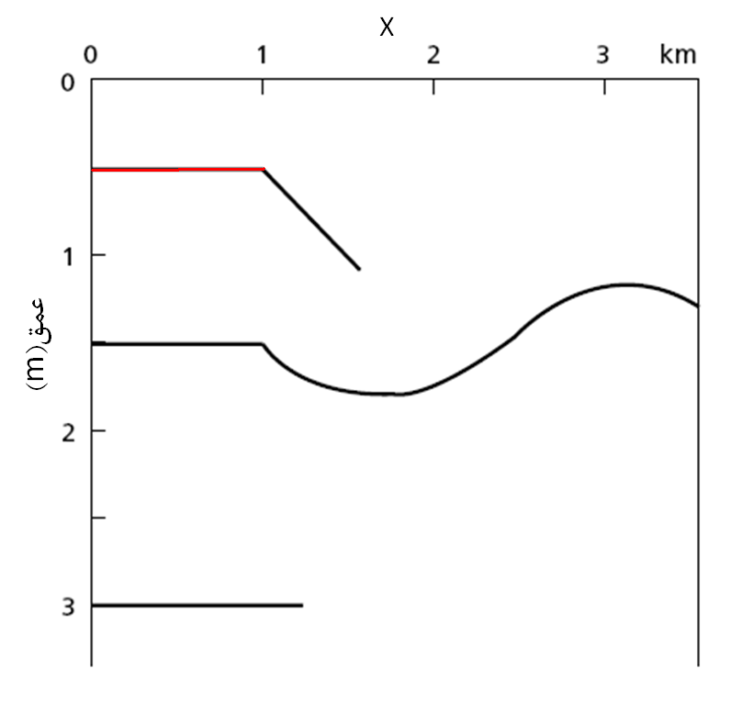
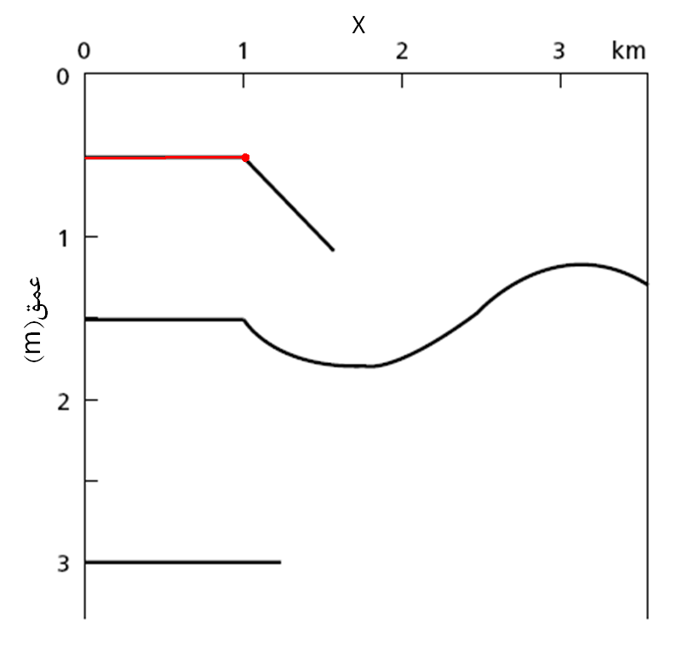
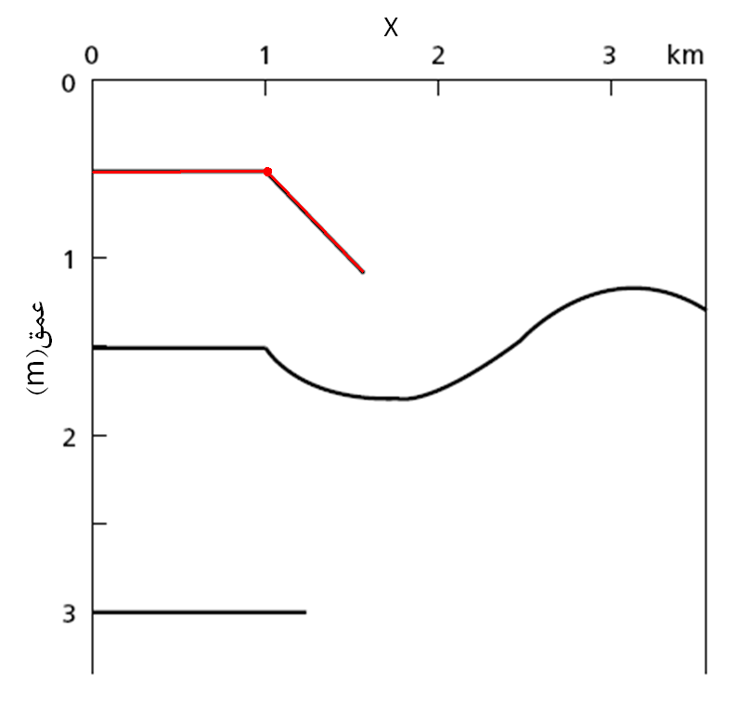

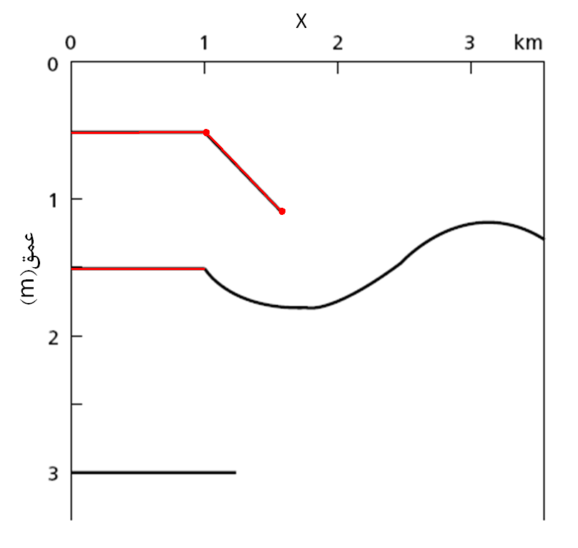

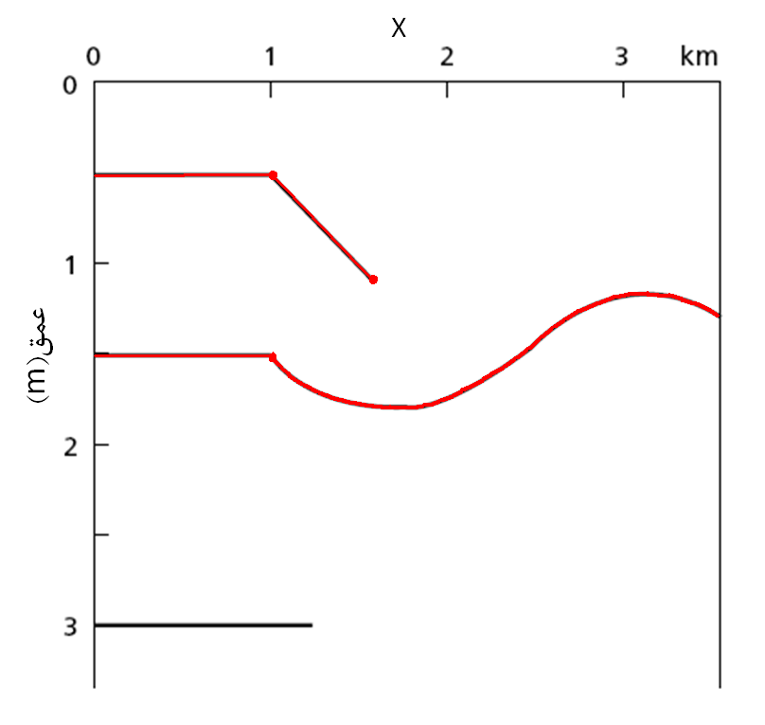
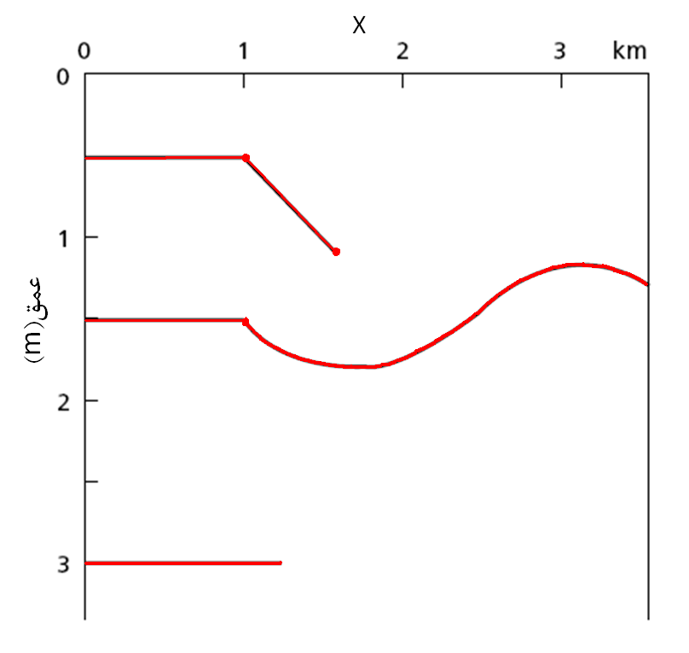
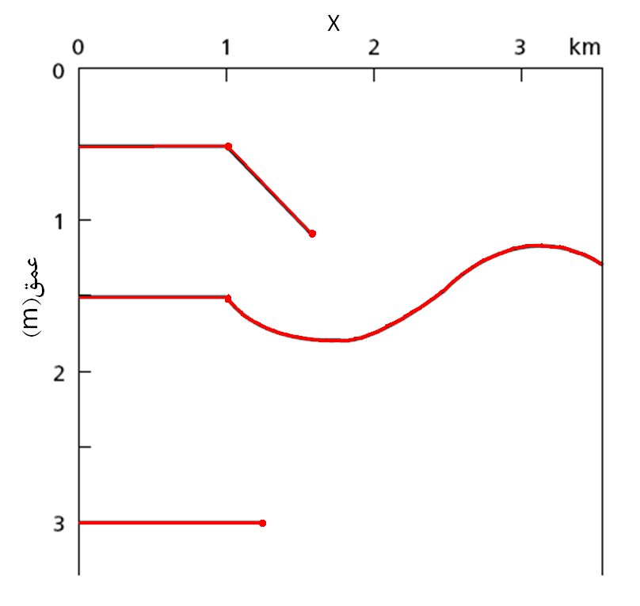
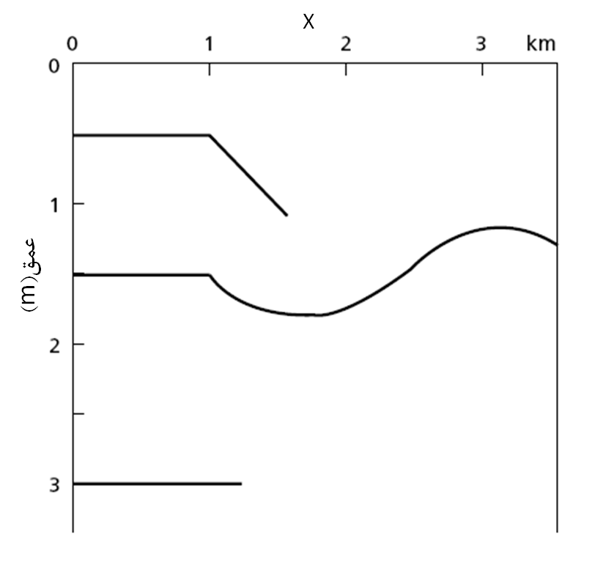
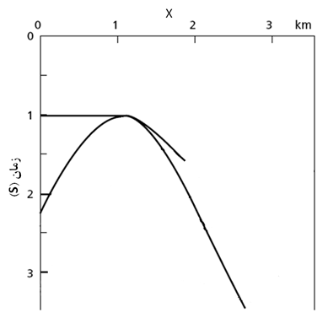
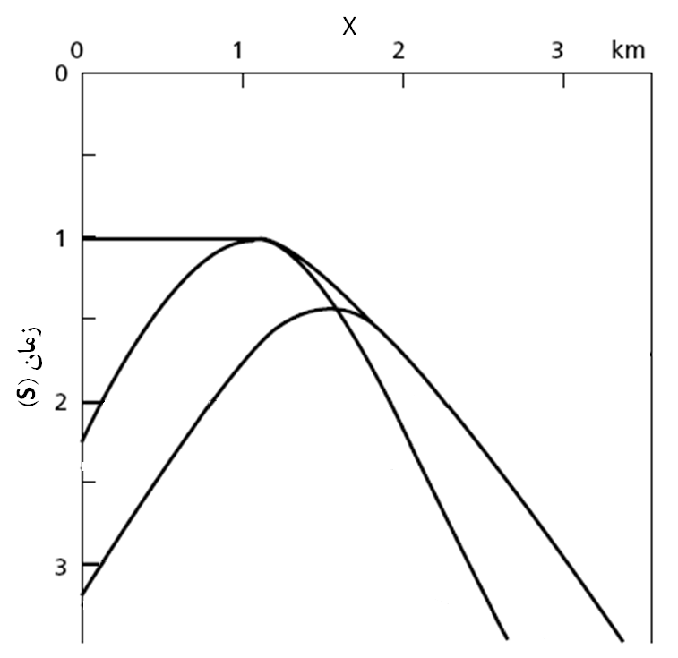
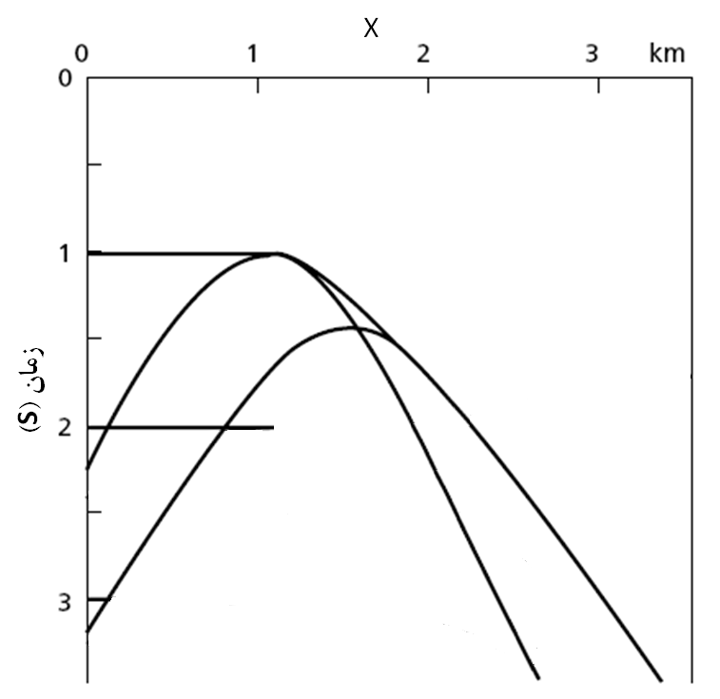
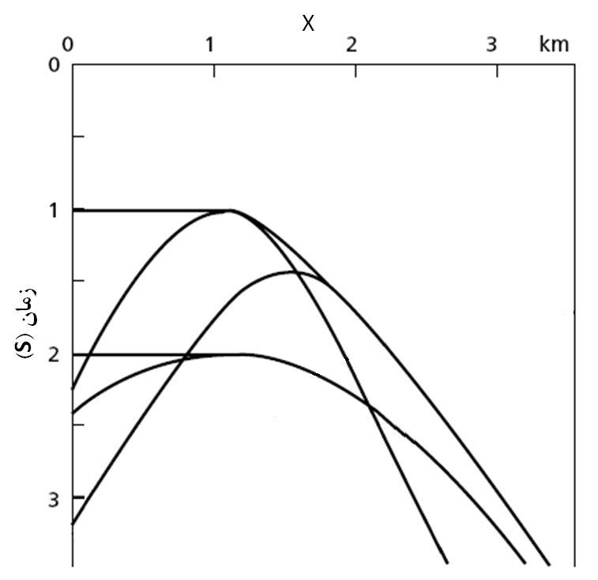
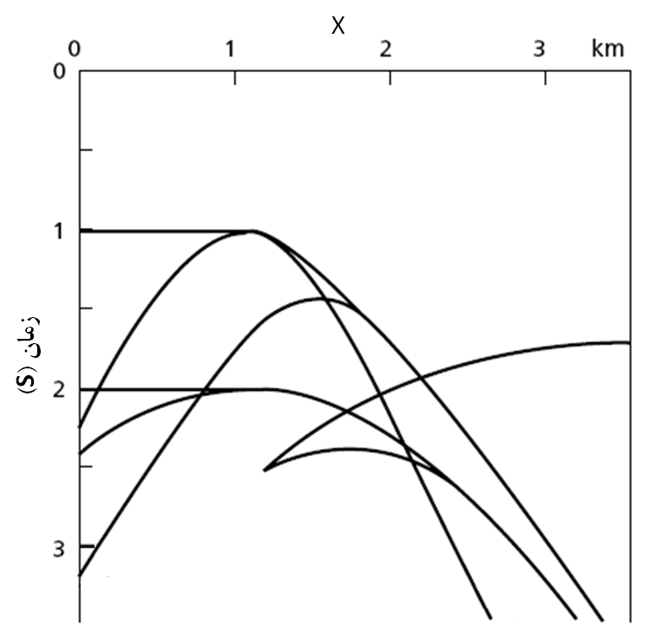
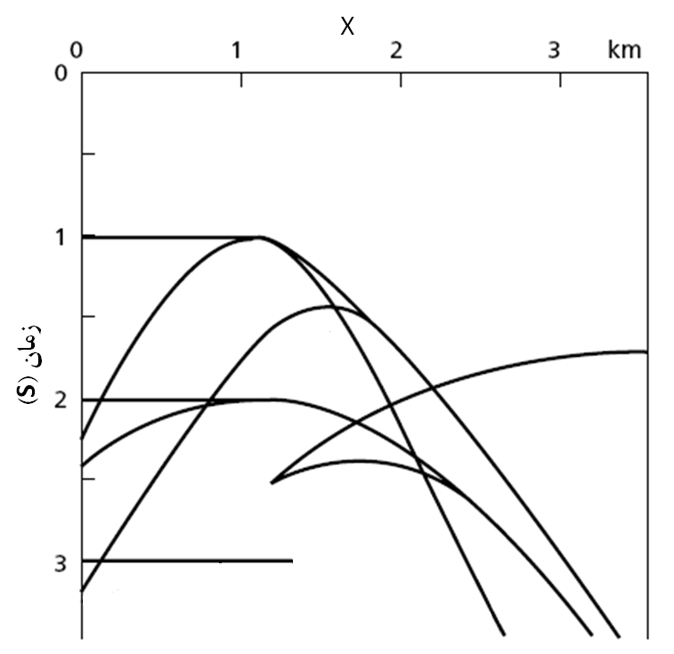
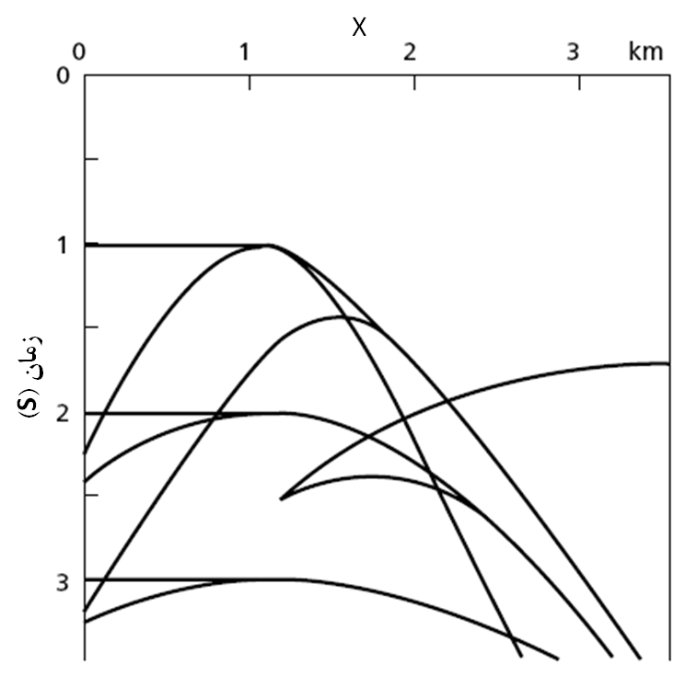
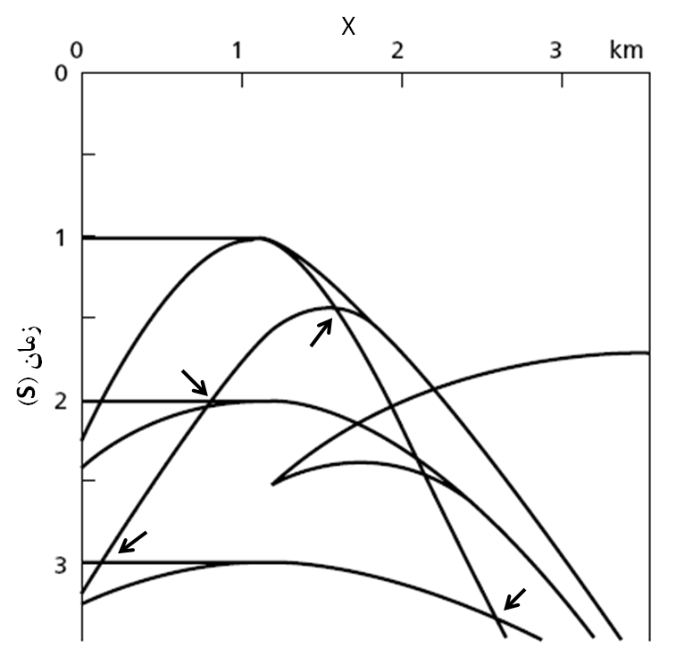
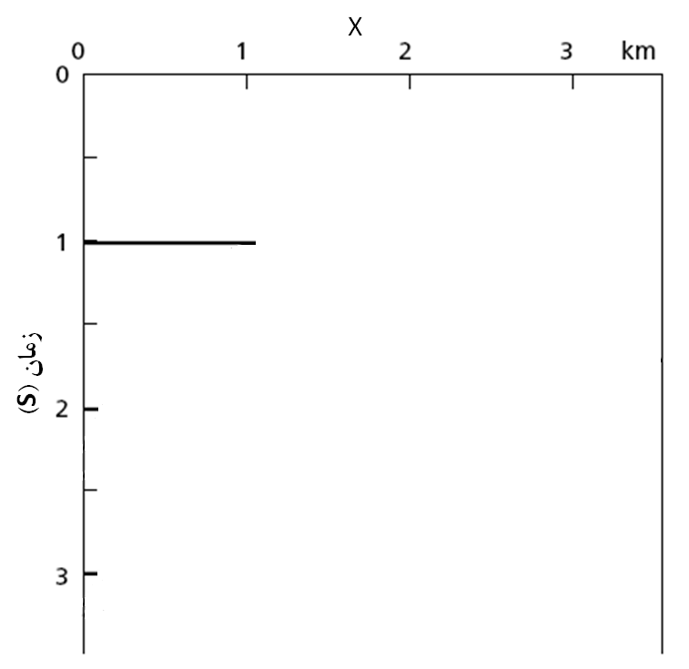
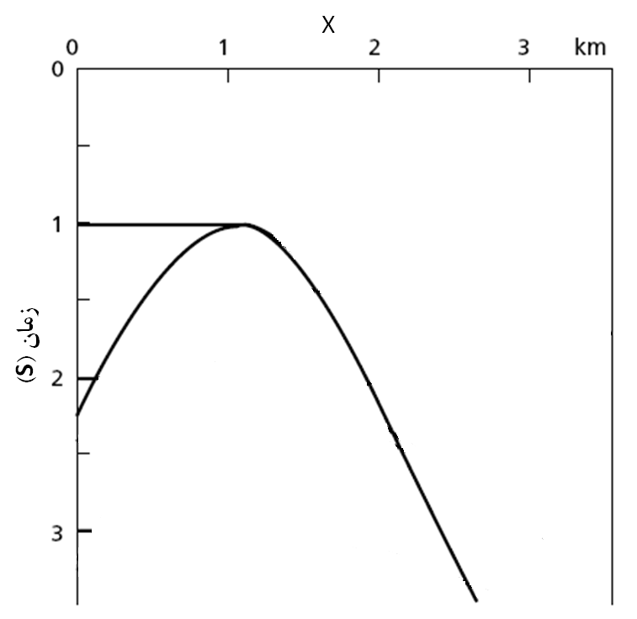
Introduction
MBCDS stack
Common-Reflection-Surface (CRS) stack
conflicting dip situations
Depth(Km)
Time(s)
Notes:
Conflicting dips mains more than one event contribute to a zero offset sample. Here I show you a very simple underground structure model. I will show you the seismic response of this model one by one…..
As show here by arrow we can find several zero-offset point that more than one event contributing to the one samples of ZO section. In other word in present of curved reflectors and diffractors the events intersect with each other or them self. The CRS stack method just consider one operator which have maximum coherence with seismic reflection data and neglect other event which have lower coherence. such that a single stacking operator per ZO sample is no longer appropriate.

Slide 6
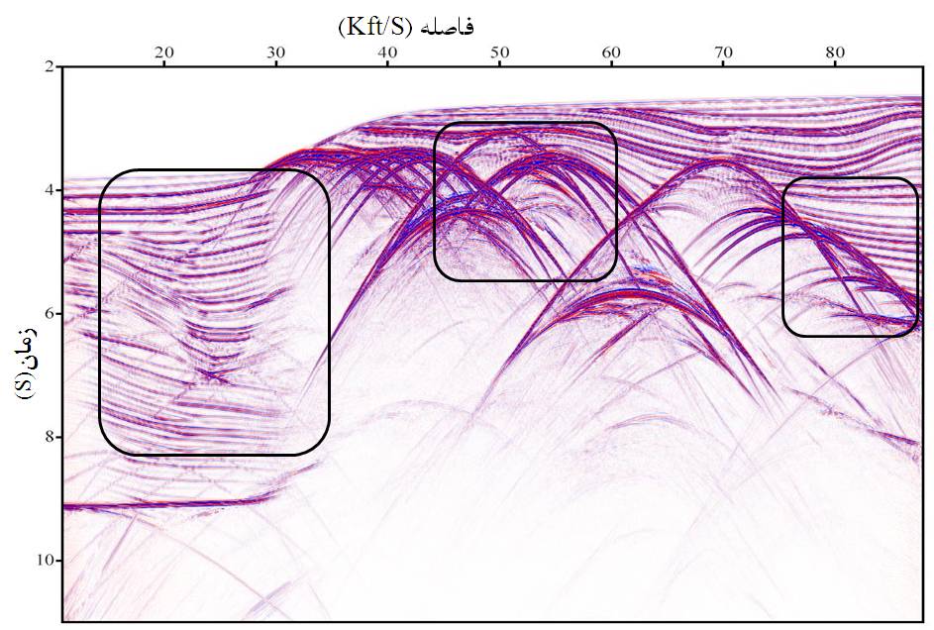
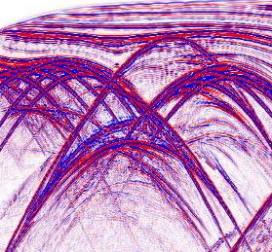
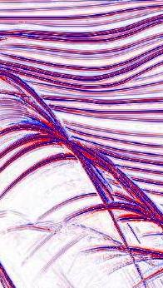
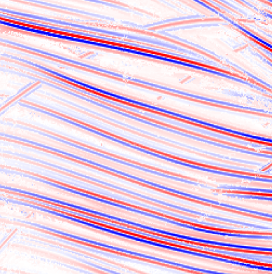
Introduction
MBCDS stack
Common-Reflection-Surface (CRS) stack
conflicting dip situations
Notes:
here I show zero-offset stack section which has been obtained by using CRS method. In the left side and in center of this section we have diffractor with high energy and cover reflect that have less energy. And in the right hand side you see the reflector which have high energy cover the hyperbola of diffractors.
We face to problem when we want to migrate a zero-offset section which has confliction dips. Because for example when we want to sum along this hyperbola and assign it to the diffractor point there is no energy. And here we may lose the continuity of reflector or cause smile in migrated section.

Slide 7
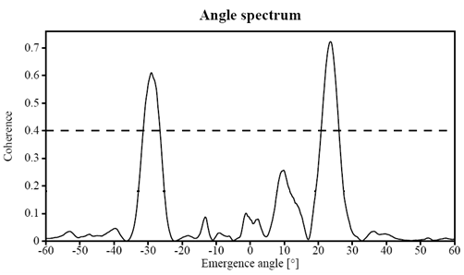
Introduction
MBCDS stack
Common-Reflection-Surface (CRS) stack
extended CRS stack
Notes:
to deal with conflicting dip extended crs method has been introduce In this method, instead of considering just one operator for stacking several operator consider for stacking for each sample of zero-offset. For this porpoise for each sample of zero-offset section firs we have to calculate Coherence as a function of emergence angle along a linear operator in the CMP stacked section. In this way we obtain angle spectrum for each sample. Now we assume a threshold for the coherence in angle spectrum. Now we perform stacking along the operators which has more coherence than this threshold. ???Here the result of this method as you see this…???
The main difficulty in this approach is to identify conflicting dip situations and to decide how many contributions should be considered. This ???implies a tricky balancing between lacking contributions and potential artifacts due to the unwanted parameterization of spurious events.??? Another method proposed to deal with conflicting dips is CDS

Slide 8
Introduction
MBCDS stack
Common-Diffraction-Surface (CDS) stack
R_{NIP}
R_{N}
Notes:
In this method by merging concepts of the dip move out correction with the CRS approach, instead of considering only a few number of dips or stacking operators per sample, almost a continuous range of dips is considered. As I mentioned The CRS method is based on an analytical approximation of the reflection travel time up to second order. For diffractor in the subsurface, an exploding point source experiment and an exploding reflector experiment naturally coincide, such that RNIP RN. Thus, for diffraction events, the CRS travel time equation reduces to the CDS travel time approximation. ????For reflection events, the CDS operator is an inferior approximation compared to the CRS operator as RNIP !=RN. But ????with a reasonable chosen aperture it can approximate the event as wellRcds which estimate by this data-based method is a weighted average of Rn and Rnip whereas in model based method which propose here Rcds is equal to Rnip????

Slide 9
Introduction
MBCDS stack
Common-Diffraction-Surface (CDS) stack
Notes:
This approach is quite time consuming, as separate stacking operators have to be determined for each stacked sample to be simulated and each considered dip in a data-driven manner by use of coherence analysis in the prestack data. Here we are going to propose a model base method to the CDS stack. This approach is far more efficient than the data-driven approach and further emphasizes.

Slide 10
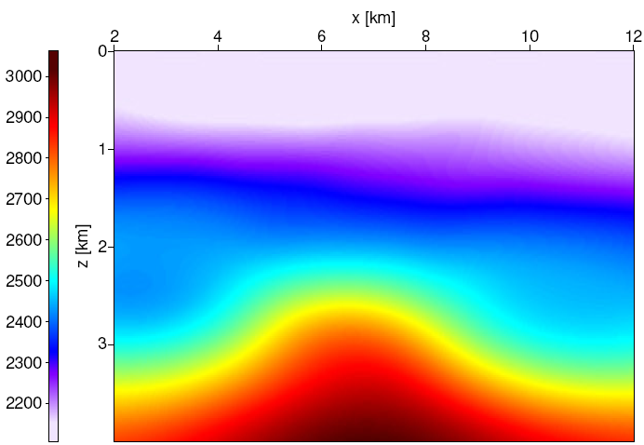
Forward-modeling
MBCDS stack
Model-based CDS stack
θ_{emerge}
Velocity(m/s)
Notes:
We assume that a smooth macro-velocity model has already been determined in which the parameters of the CDS stacking operators can be
easily forward-modeled. Assume a diffractor on depth. A beam from this diffractor receive to surface with radius which is equal to Rcds. In other word it is possible to calculate the curvature of wave front along the normal ray. Of course we want to calculate the curvature at the surface. Thus, the first step is using kinematic ray tracing to determine the ray path. As we need this ray for a given surface location and a given emergence angle, and given time the kinematic ray tracing is performed for the down-going ray

Slide 11
Forward-modeling
MBCDS stack
Model-based CDS stack
θ_{emerge}
Velocity(m/s)
Notes:
As we need this ray for a given surface location and for a given emergence angle, and given time, the kinematic ray tracing is performed for the down-going rays.

Slide 12

Forward-modeling
MBCDS stack
Model-based CDS stack
kinematic Ray Tracing
characteristic system
Notes:
Kinematic ray tracing consists in the calculation of the characteristics of the Eikonal equation. as we have to compute ray tracing equation system for a regular grid in ZO travel time, We have chosen the particular system for which the variable along the ray is directly the travel time. This system consists of four ordinary non linear differential equation and numerically integrated with well-known Rung-Kutta method.

Slide 13



Forward-modeling
MBCDS stack
Model-Based CDS stack
dynamic ray tracing
ray- centered coordinate system
Notes:
The determination of RNIP requires dynamic ray tracing along the ray path. The dynamic ray tracing system can be expressed in many forms and in various coordinate systems. The simplest form of the dynamic ray tracing system in isotropic media is obtained in ray-centered coordinates connected with ray. The 2D dynamic ray tracing system consists of two coupled ordinary differential equations.

Slide 14
Forward-modeling
MBCDS stack
model-based CDS stack
θ_{emerge}
Velocity(m/s)
Notes:
with upward ray tracing we wouldn’t be able to determine time, location and emergence angle which our ray receive to the surface before performing ray tracing. Therefore we must perform downward kinematic ray tracing the Then for calculation the curvature at surface we have to performing upward dynamic ray tracing for each sample along the ray individually. But this approach is too time consuming. As we have many rays and along these rays we have a lot of sample. To decrease time of computation we solve dynamic equation system for two orthogonal initial condition downward. In this way we would be able to calculate the curvature of upward rays on every sample along the ray just by one way down going ray tracing. To decrease time of computation we have to solve dynamic equation system for two orthogonal initial condition downward. One of this initial condition is plane wave. In this way by calculating the propagation matrix it easy to calculate back propagation matrix and then obtaining the curvature of nip wave at the surface.

Slide 15
Forward-modeling
MBCDS stack
model-based CDS stack
θ_{emerge}
Velocity(m/s)
Notes:
In this way we would be able to calculate the curvature of upward rays on every sample along the ray just by one way down going ray tracing.

Slide 16
Forward-modeling
MBCDS stack
model-based CDS stack
Notes:
Therefore for a given location and for a given time and for a given angle we solve kinematic and dynamic ray tracing systems simultaneously which consist of eight equation. And then we repeat this process for all given angles. By this way we have the curvature of all deflator along the isochron associated to the given time. Know we have all parameters for CDS stacking operator.

Slide 17
Forward-modeling
MBCDS stack
model-based
CDS stack
workflow
CRS stack
smoothing & picking
NIP-wave tomography
model accuracy sufficient?
Yes
No
model-based CDS stack
prestack depth migration
poststack depth migration

Slide 18
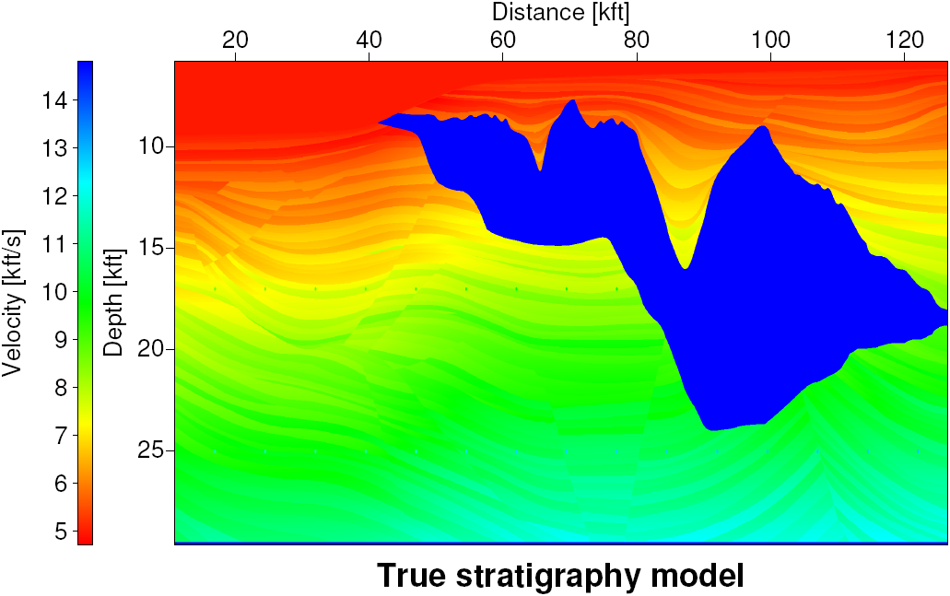
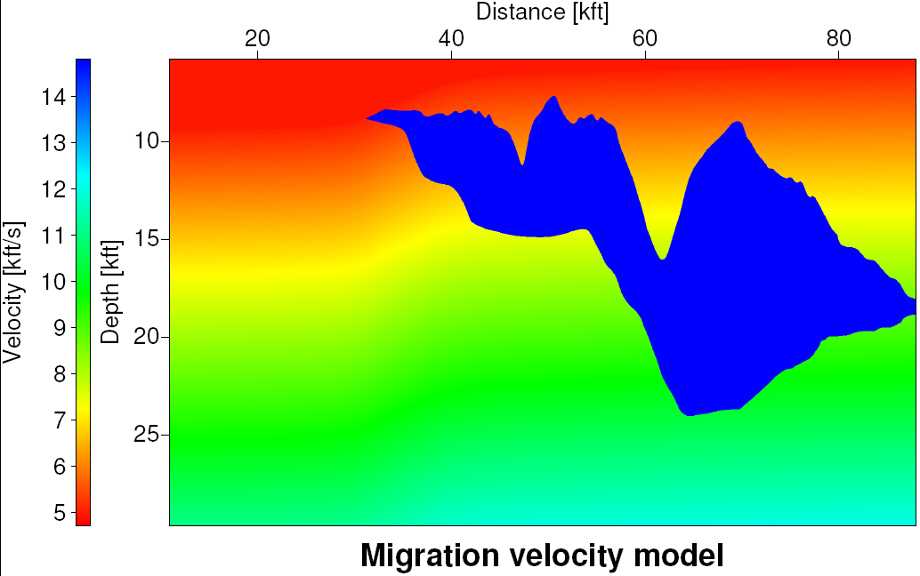
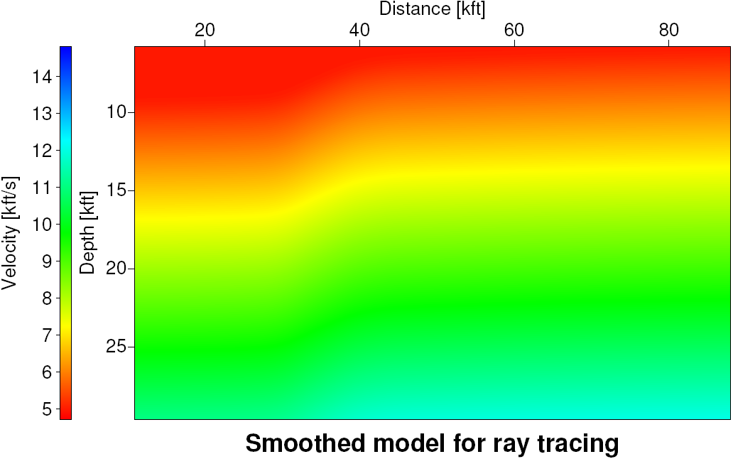
Implementation
MBCDS stack
Sigsbee2A model:
Faults
Diffractors
Notes:
For the first application of the model-based method we revisited Sigsbee2A data set which is a synthetic 2D marine data set. The model has a stratified back ground associated with a relatively smooth macro-velocity model and contain the salt body with a quite complicated geometry. At right hand side there is some faults and almost regular diffractors. Migration velocity model…
For performing ray tracing fist we have to remove the salt body. …

Slide 19
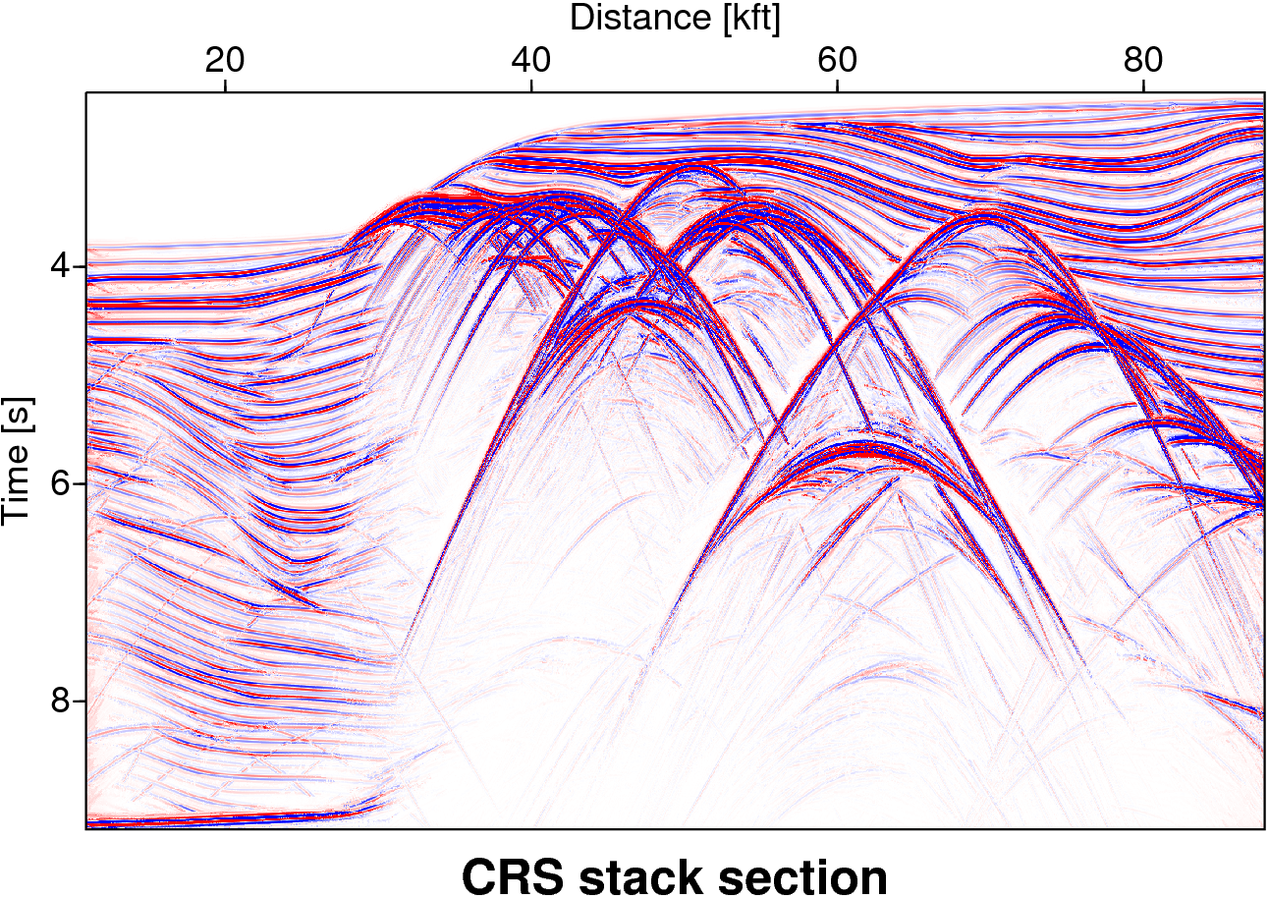
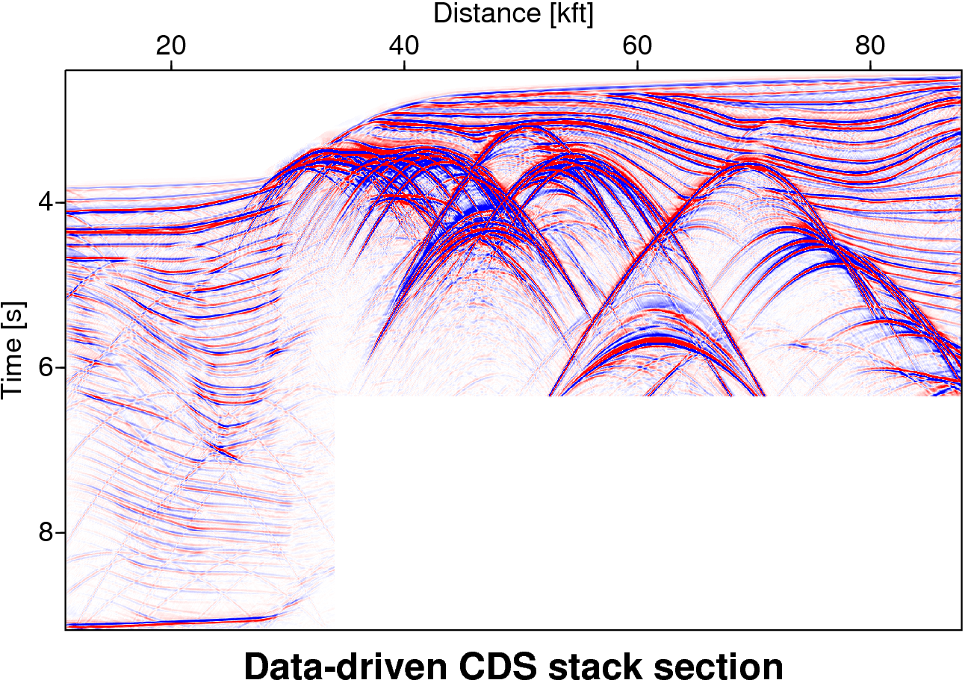
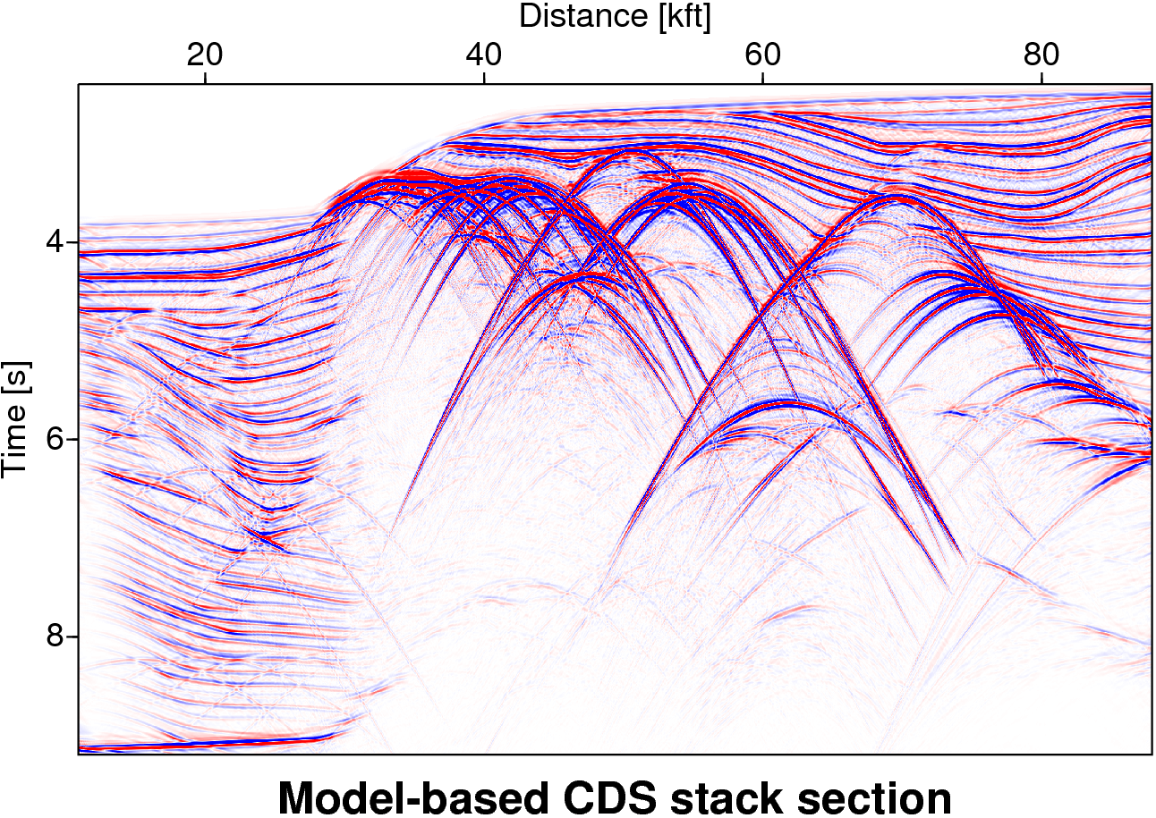
Implementation
MBCDS stack
Computation time : 6 hours
Computation time : 594 hour

Slide 20
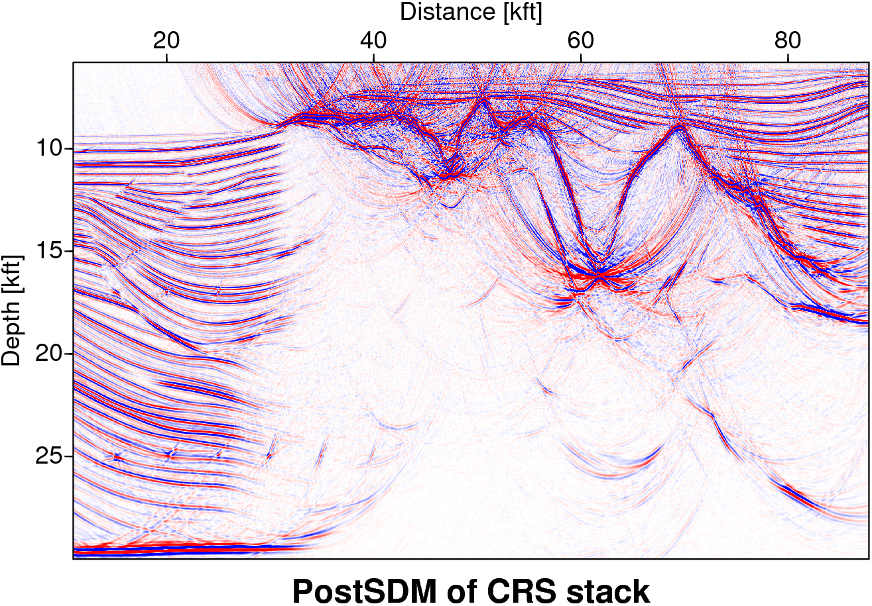
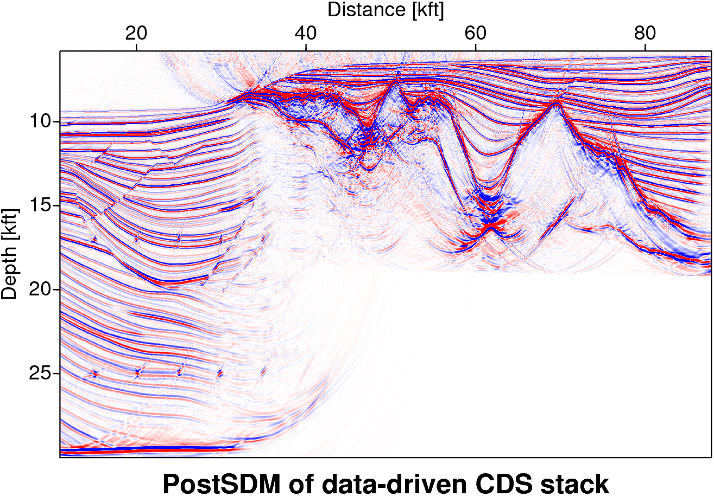
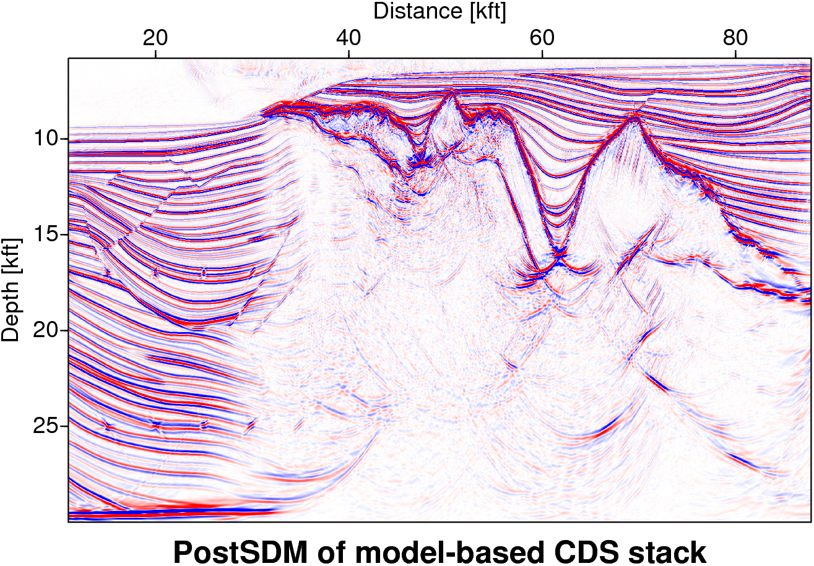
Implementation
MBCDS stack
Faults
Diffractors

Slide 21
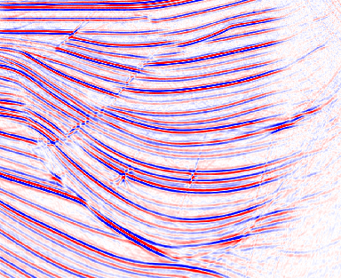
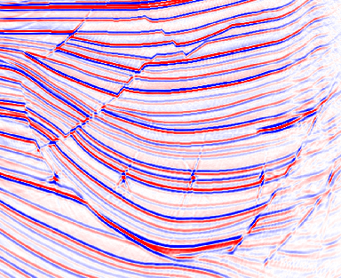
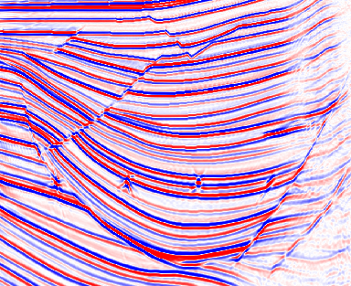
Implementation
MBCDS stack
postSDM sections:
left part
postSDM of CRS
postSDM of data-driven CDS
postSDM of model-based CDS

Slide 22
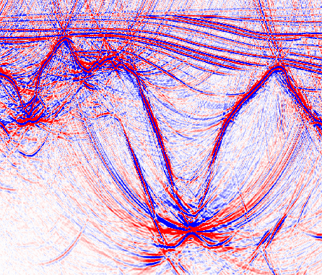
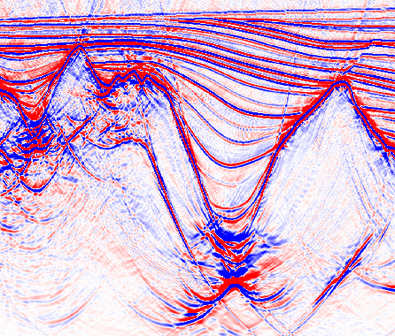
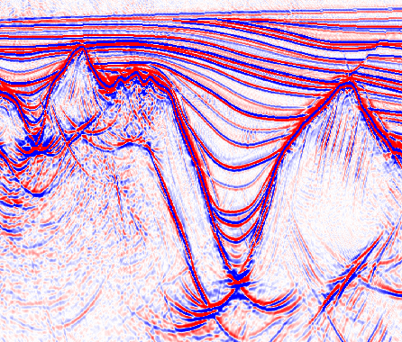
Implementation
MBCDS stack
postSDM sections:
top part
postSDM of CRS
postSDM of data-Driven CDS
postSDM of model-based CDS

Slide 23
MBCDS stack
Summary
Common-Reflection-Surface (CRS) stack method
+ high signal to noise ratio
- fails to handle conflicting dip situations
extended CRS
+ considers conflicting dip situations
- difficult to identify conflicting dip situations
data-driven Common-Diffraction-Surface stack
+ complete simulation of conflicting dip situations
- computationally very expensive
model-based Common-Diffraction-Surface stack
+ complete simulation of conflicting dip situations
+ computationally cheap
Notes:
Crs method around two decade ago base on two hypothetical experiment was introduced. This method pervious height signal to ratio with compare to the conventional stacking methods. But this method couldn’t handle the conflicting dip. Extended crs proposed to overcome this drawback. This method like the previous method had some drawback and this method could not handle conflicting dips to some extent. Common diffraction surface stack which is data driven method has been proposed . However this method can handle the conflicting dip as well but this method computationally is too expensive.
In this research we proposed a model based method which need just a smooth micro-velocity. The result of this method which has been applied on synthetic how the efficiency of this method.

Slide 24
Acknowledgements:
Ministry of Science, Research and Technology, Iran
Wave Inversion Technology (WIT) consortium
Sigsbee 2A data provided by the Subsalt Multiple Attenuation And Reduction Technology Joint Venture (SMAART JV)

